Slide 1
Deploy monolith, microservice and serverless architecture to AWS
Draft – Filippo di Pisa

Slide 2
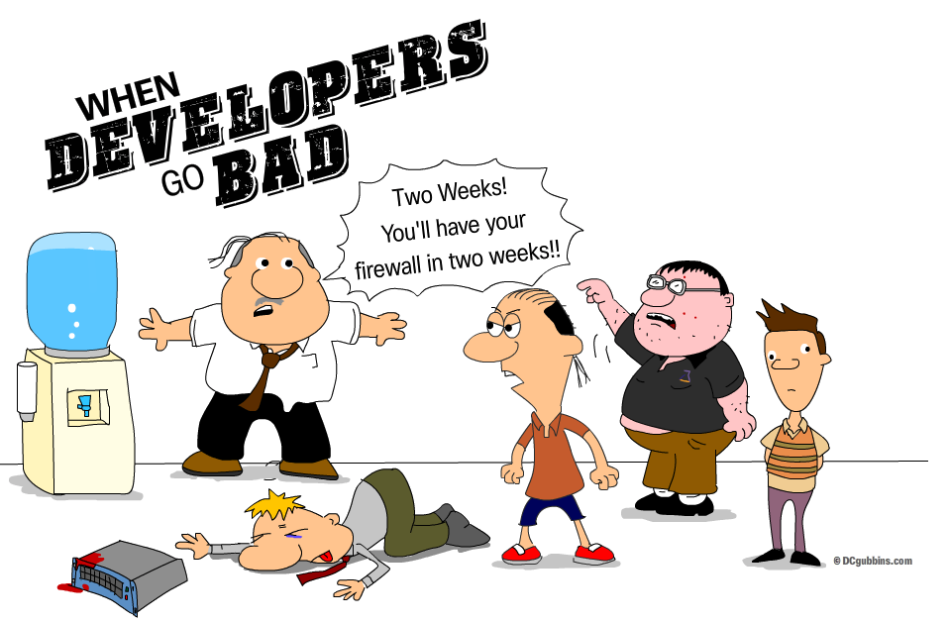
The dev/ops challenges
Continuous deployment of code across different environments and infrastructure
• Infrastructure provisioning
• Environment and application scaling
• Monitoring and logging
Test Automation
Security

Slide 3
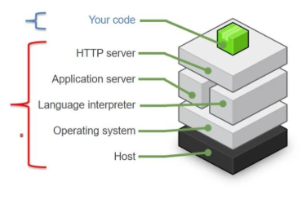
Elastic beanstalk
Elastic Beanstalk (EB) is considered Platform as a Service (PaaS) that allows developers to focus on development and not worry about infrastructure tasks.
Developer
EB
Notes:
AWS Elastic Beanstalk (EB) is a layer of abstraction on the AWS Elastic Container Service that adds some convenient wrapping around the Elastic Container Services’ features.

Slide 4
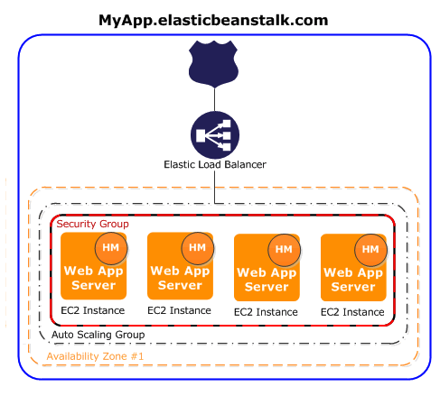
EB benefits
Easy deployment, monitor, scaring applications
Automatically provisioning infrastructure including EC2 servers, load balancers, security groups, auto scaling groups, Cname ( AWS Route 53 )
Preconfigured and easily customizable containers
provides platforms for programming languages (Java, PHP, Python, Ruby, Go), web containers (Tomcat, Passenger, Puma), and Docker containers, with multiple configurations of each.
Elastic Beanstalk also supports custom platforms that can be based on an AMI that you create and can include further customizations.
Custom platforms are region specific.
Low learning curve
Notes:
AWS Elastic Beanstalk (EB) is a layer of abstraction on the AWS Elastic Container Service that adds some convenient wrapping around the Elastic Container Services’ features.

Slide 5
EB key concepts
Enviroments
We can easily create and manage environments for our application, such as EC2 instances and ELB load balancers
An application can have many environments
2 types: single instance or load balanced
Application versions
An application can have many application versions
A single version is run at a time
All versions are stored in S3
Easy rollbacks
Saved configurations
We can save our environment's configuration as an object in Amazon S3 that can be applied to other environments during environment creation, or applied to a running environment.
Easy creation of a new environment
An application can have many saved configurations

Slide 6
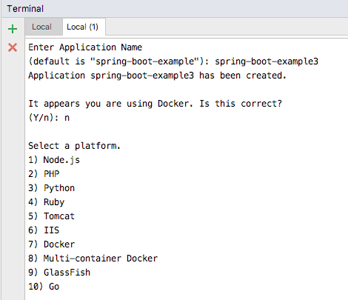
Deployment options
Via AWS console
Via GIT + EB CLI
Via AWS toolkits
Using the Maven plugin
Via CI and pipeline

Slide 7
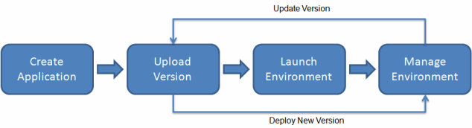
Deployment flow
Elastic Beanstalk’s default deployment process consists of the following stages :
Build artifact locally or through CI
upload code to AWS
compile code
deploy artifacts to EC2 servers
For Java applications for example we can choose to deploy as standalone Java application, tomcat or docker.
For spring boot application for example we can use the Java option. As in other PaaS like PCF we can just add some config into a yml file and EBS will do everything for us.

Slide 8
EB maven plugin
Even though the AWS CLI can do everything we need, there are legitimate reason to use the beanstalker maven plugin instead :
Keep all Elastic Beanstalk configuration in one place, the pom.xml
No need to install the CLI
Out of the box integration with any CI system that can run maven
<plugin> <groupId>br.com.ingenieux</groupId> <artifactId>beanstalk-maven-plugin</artifactId> <version>1.5.0</version> <configuration> <applicationName>spring-boot-aws-elasticbeanstalk </applicationName> <s3Bucket>szp-spring-boot-aws</s3Bucket> <s3Key>${project.artifactId}/${project.build.finalName}.jar</s3Key> <cnamePrefix>spring-boot-aws-elasticbeanstalk-dev</cnamePrefix> <environmentName>dev</environmentName> <environmentRef>dev</environmentRef> <solutionStack>64bit Amazon Linux 2016.09 v2.4.0 running Java 8</solutionStack> </configuration> </plugin>

Slide 9
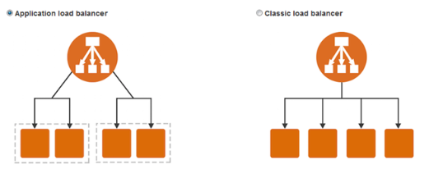
Elastic Beanstalk load balancer types
Classic Load Balancer – Routes HTTP, HTTPS, or TCP request traffic to different ports on environment instances.
Application Load Balancer – Routes HTTP or HTTPS request traffic to different ports on environment instances based on the request path.
Network Load Balancer – Routes TCP request traffic to different ports on environment instances. Supports both active and passive health checks.

Slide 10
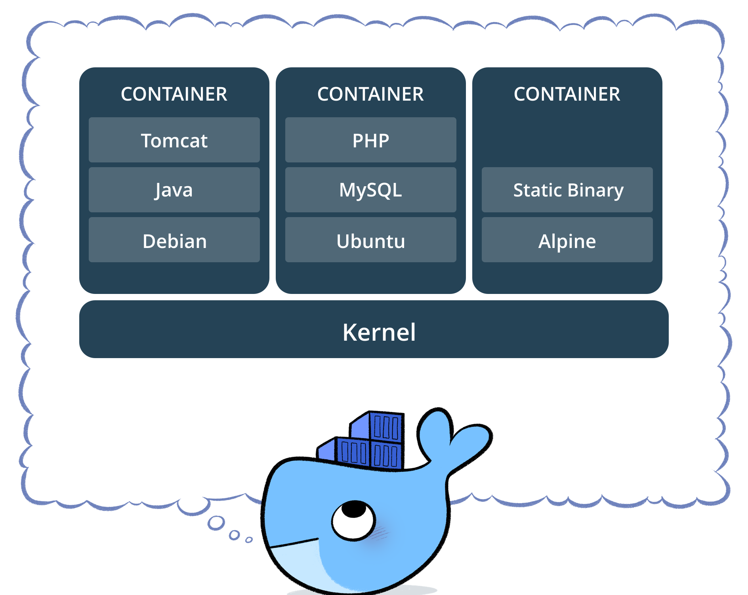
Containers
Container platform allows to run programs in containers, isolated from the rest of the operating system.
Running applications this way leads to better composability, organization, and helps build immutable infrastructure that’s more robust and easier to manage.

Slide 11
Docker
Docker is one of the most popular container platform
Docker is hotter than hot because it makes it possible to get far more apps running on the same old servers and it also makes it very easy to package and ship programs.
The following docker file tells docker to create a container with Java8 installed and then run the spring boot java application.
FROM anapsix/alpine-java:8_server-jre_unlimited ADD target/spring-boot-aws-elasticbeanstalk-0.0.1-SNAPSHOT.jar app.jar RUN sh -c 'touch /app.jar' ENV JAVA_OPTS="" ENTRYPOINT [ "sh", "-c", "java $JAVA_OPTS -Djava.security.egd=file:/dev/./urandom -jar /app.jar" ]

Slide 12
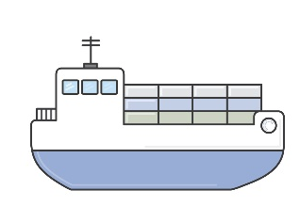
Elastic beanstalk and Docker container
Elastic beanstalk offer the options to use preconfigured or generic Dockers containers.
The Docker platform for Elastic Beanstalk has two generic configurations:
single container
multicontainer

Slide 13
Elastic beanstalk Docker Single container
The Single Container Docker platform is against the Docker philosophy practices by forcing you to run your entire application from a single container which simply is not using Docker in the way it was intended.
Using single container we could run into problems when we have multiple machines, lots of containers that may need to communicate with one another, need to reliability update containers, and load balance traffic among them.

Slide 14
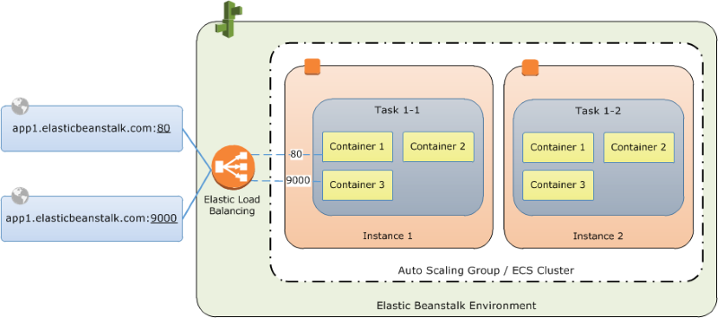
Elastic beanstalk Docker Multi container
Elastic Beanstalk (multi-container) is an abstraction layer on top of ECS (Elastic Container Service) with some bootstrapped features.
Automatically interacts with ECS and ELB
Cluster health and metrics are readily available and displayed without any extra effort
Easily adjustable autoscaling and instance sizing
Manageable environment variables

Slide 15
and some limitations:
Load balancer must terminate HTTPS and all backend connections are HTTP
Can only set hard memory limits in container definitions
All cluster instances must run the same set of containers
Slow deployments and rollbacks
Stack upgrades

Slide 16
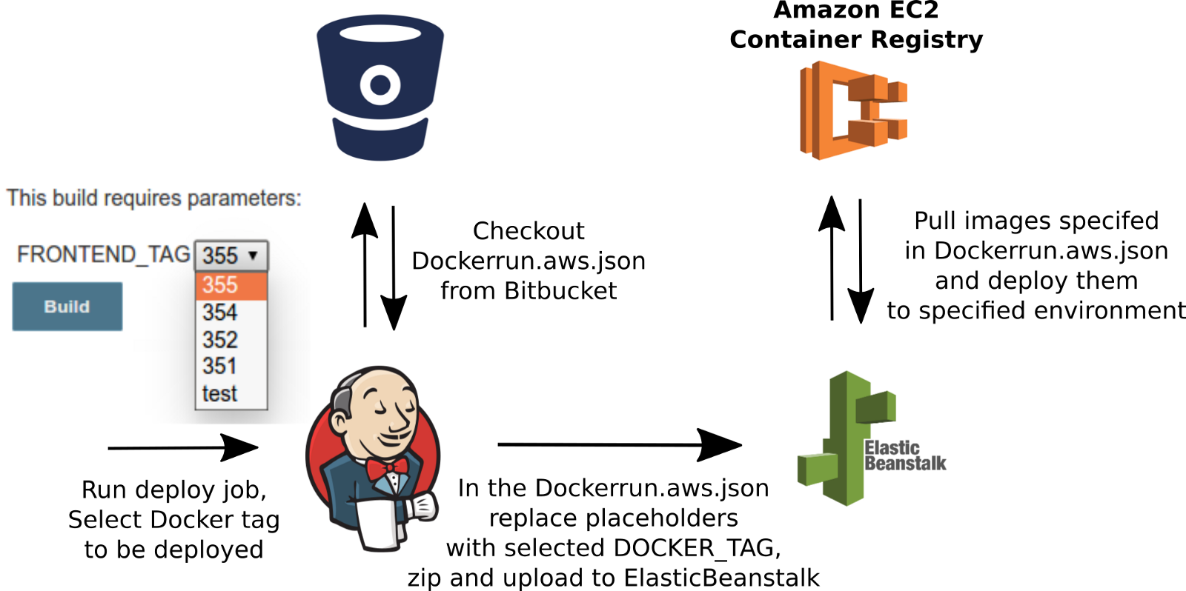
Deploying Docker container to Elastic Beanstalk
Dockerfile
Dokerrun.aws.json
Applicaton archive that include either the Dockerfile or the Dockerrun

Slide 17
ECR(Elastic container registry)
ECR is a private docker container registry
Store, manage, and deploy container images
Encrypted
Granular IAM security permission
Once we have the images stored into the registry, the next instance is running them in the cloud.

Slide 18
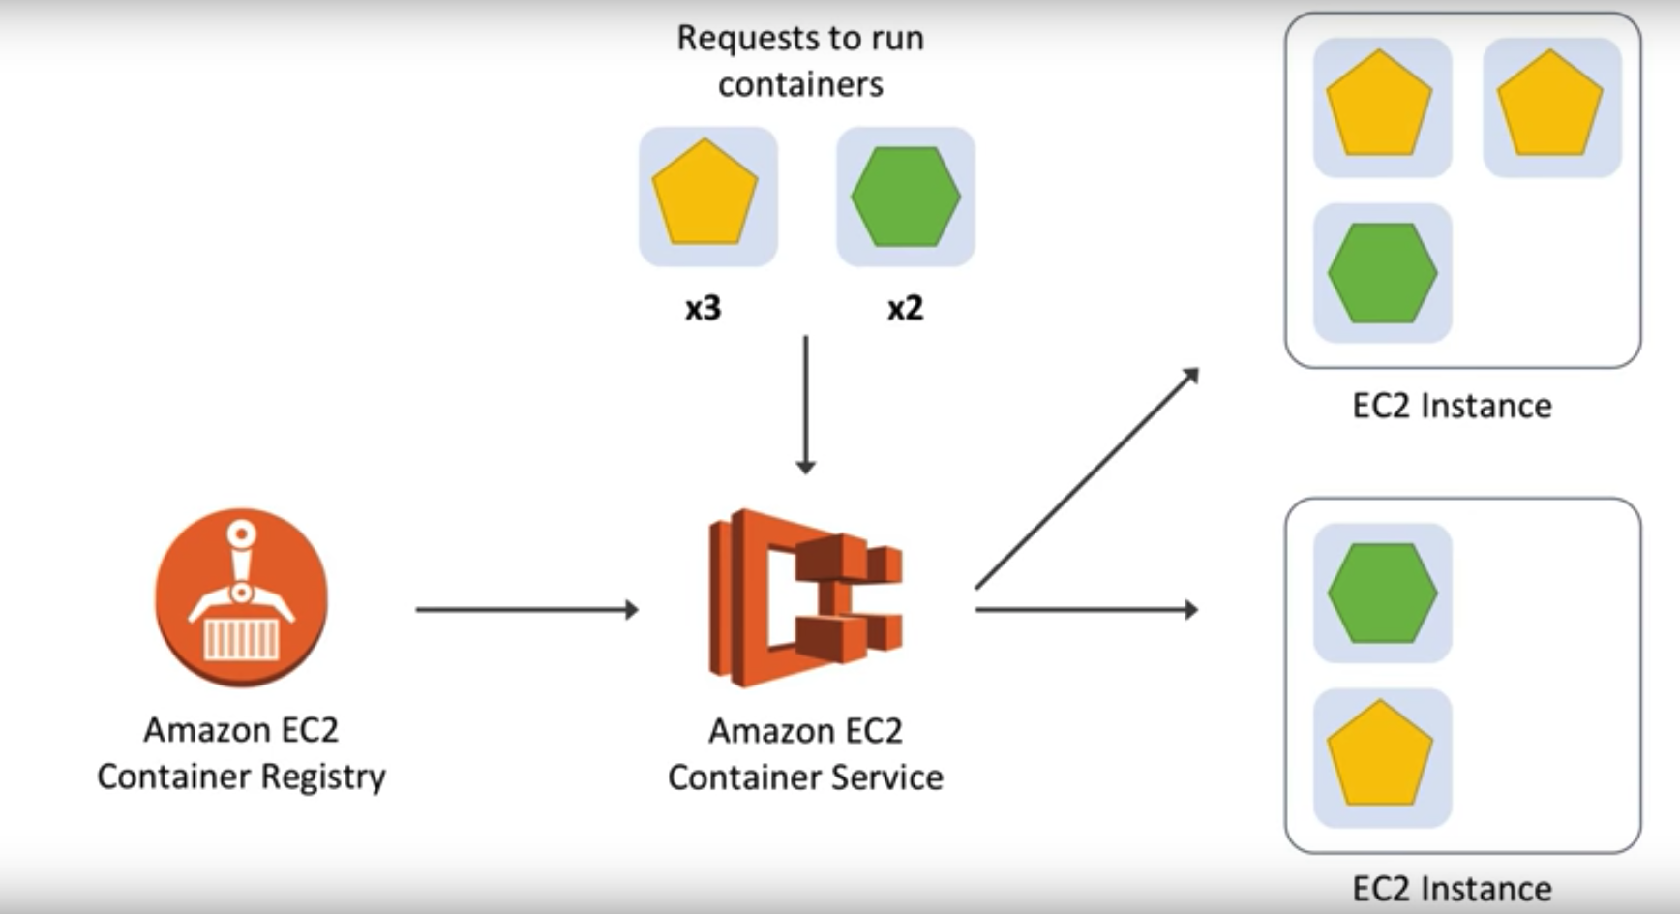
ECS (ELASTIC CONTAINER SERVICE)
ECS is Amazon’s answer to container orchestration.
ECS allows to deliver and orchestrate containers across different EC2 instances.
All of the limitations imposed by Elastic Beanstalk are lifted.
ECS does have a straightforward approach to declaratively defining containers which allows you to easily compose several “container definitions” within a “task definition”.
AWS is releasing soon access to AWS EKS (Elastic Container Service for Kubernetes).

Slide 19
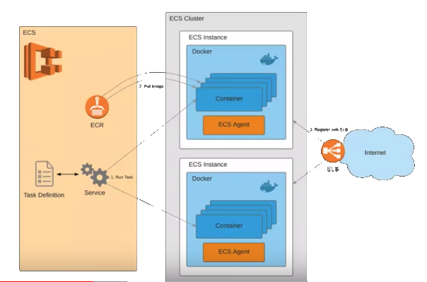
ECS Components
Cluster – container instances
Container Instance – instance that host containers
Task – docker containers
Service – a group of tasks

Slide 20
Create Cluster
ECS cluster is a group of instances that each run docker
Give a cluster. Name
Choose the instance type
Choose the VPC – Instances are linked in a VPC
Choose the Security group

Slide 21
Create Tasks
An ECS task deploys containers onto EC2 instances in your cluster.
Each task includes one or more container definitions, allowing you to group containers together into a logical set that’s launched and terminated at the same time.
Task specify the container information
Docker image for each container
Links between containers
Cpu and memory requirements for each container (hard and soft )
Data storage volumes
Security

Slide 22
Run task
Finds EC2 instances in cluster to meet the task definition
Defines the distribution of tasks on instances in the cluster
Use the ECS-Agent to run the containers

Slide 23
Create service
Select the task
Select the cluster
Give the service name
Number of taks ( number of containers )
Monitor running tasks
If any of your tasks should fail or stop for any reason, the Amazon ECS service scheduler launches another instance of your task definition to replace it and maintain the desired count of tasks in the service depending on the scheduling strategy used.

Slide 24
CI with ECS
Checkout from version control to CI server
Build Docker image and tag it ( app version-build number – git sha )
Push new Docker image to container registry ( ECR )
Update task definition
Update service
ECS updates containers on the cluster

Slide 25
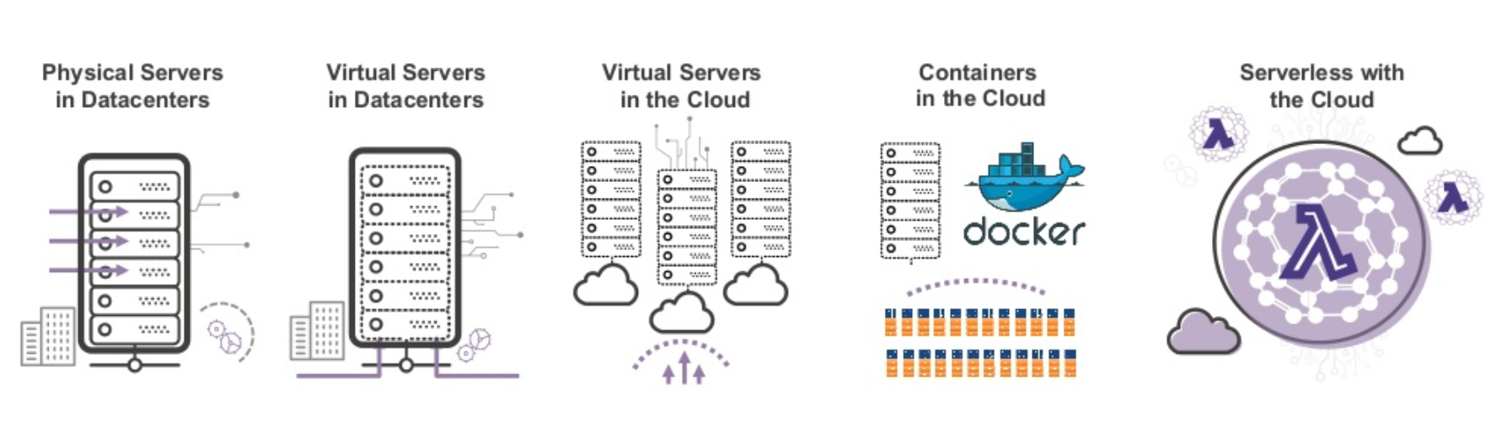
Evolving to serverless

Slide 26
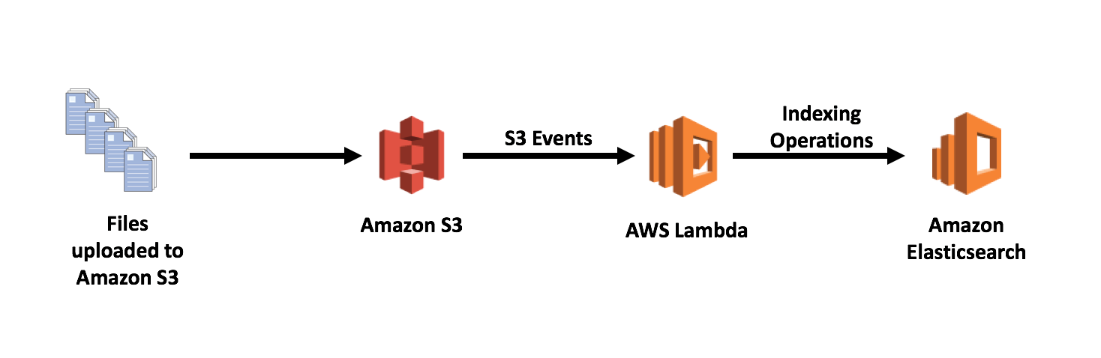
AWS Lambda
Lambda is considered a Function as a Service, whereby you create a piece of code and AWS will execute that piece of code, and only that piece of code as many times as you tell it to.
In Serverless architectures we don’t need to worry about infrastructure at all, however we still need to create Lambda functions, API Gateways, etc.. and all the configurations around it.

Slide 27
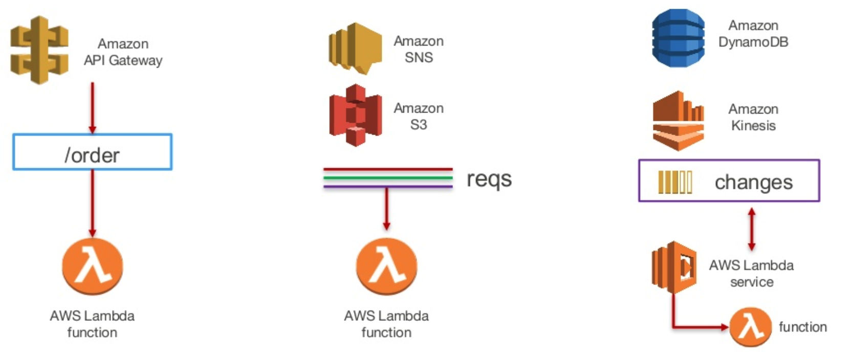
Lambda examples

Slide 28
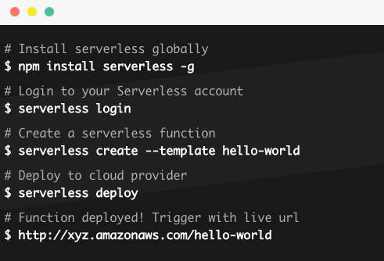
The serverless framework
The Serverless Framework provides a configuration DSL which is designed for serverless applications. It also enables infrastructure as code while removing a lot of the boilerplate required for deploying serverless applications, including permissions, event subscriptions, logging, etc.

Slide 29
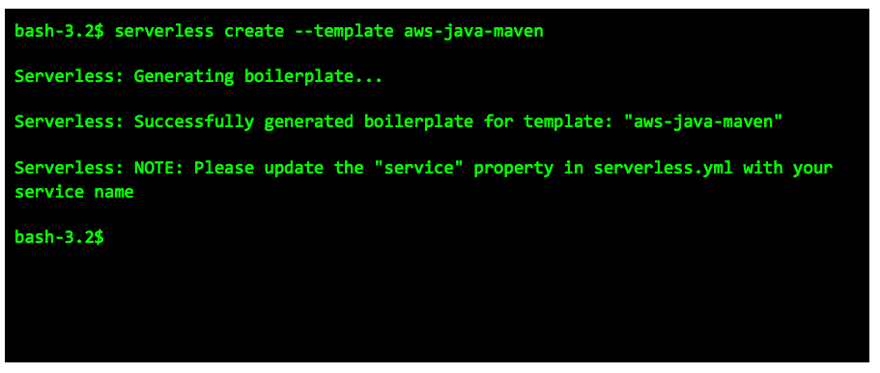
Create a Java project
When deploying to AWS, the Serverless Framework is using CloudFormation under the hood.

Slide 30
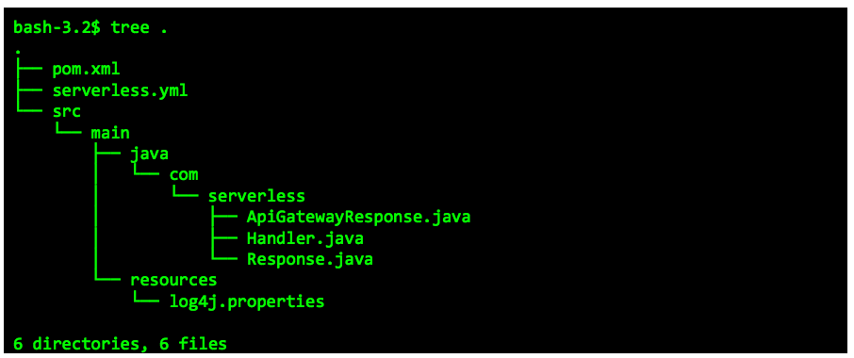
The project structure
The Serverless Framework is provider-agnostic, so you can use it to deploy serverless applications to AWS, Microsoft Azure, Google Cloud Platform, or many other providers.

Slide 31
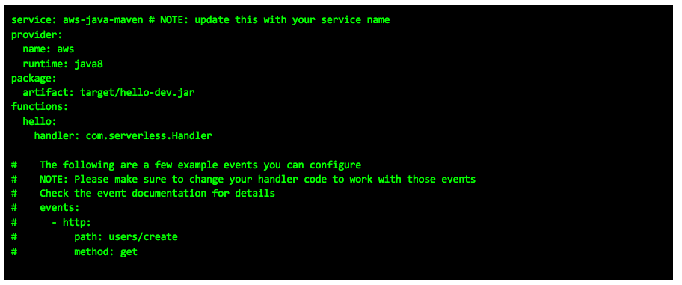
The serverless.yml

Slide 32
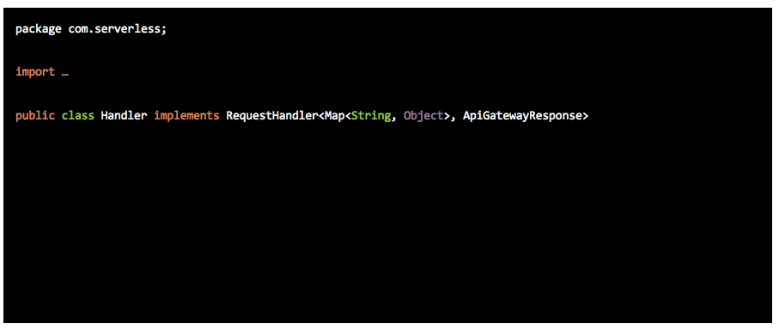
The handler class

Slide 33
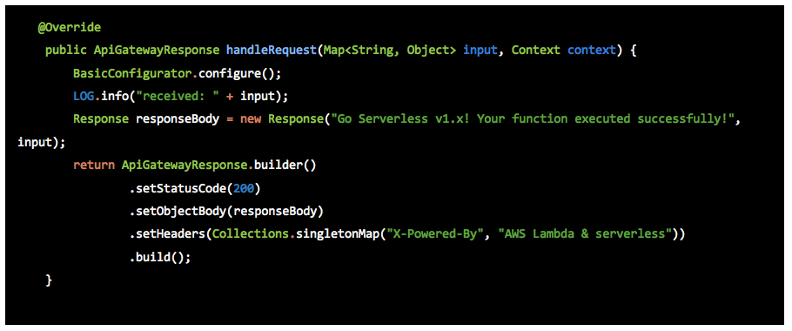
The handler method implementation

Slide 34
Serverless vs Terraform
Terraform is an unopinionated cloud deployment tool. It describes Infrastructure as Code and deploys to multiple clouds and SaaS systems at once. It is comparable to CloudFormation but for multiple clouds.
Compare with the Serveless framework, The Serverless Platform has one strong opinion about how an application is defined, and then is flexible about everything else. It facilitates developing and deploying Serverless Applications, abstracting away the boilerplate required to deploy serverless applications. It also assists with the packaging and monitoring of your serverless applications.
Terraform and the Serverless Platform are not mutually exclusive and can easily be used in tandem, however in Terraform fits more in servful architecture while the Serverless framework is a perfect firt for serverless architectures.
Terraform is good for certain things, but it is not recommend for managing your Lambdas.
It only solves the configuration aspect, so we'll have to write your own code-management scripts and then figure out how to integrate them.
Second, there's a ton of boilerplate in deploying Lambdas + setting up API Gateway. This includes setting up the proper IAM roles, configuring Cloudwatch log groups, setting up all the API Gateway stuff, etc. The other frameworks do the heavy lifting of abstracting this away from us, but we'll have to do it ourself with Terraform.
Terraform can be handy to handle more permanent aspects of their infrastructure, like databases, VPCs, security groups, etc., while using the Serverless Framework for the Lambda parts.

Slide 35
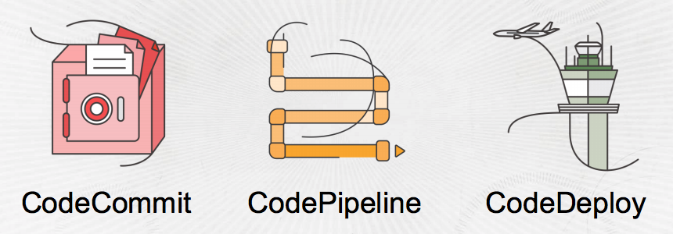
AWS Code services

Slide 36
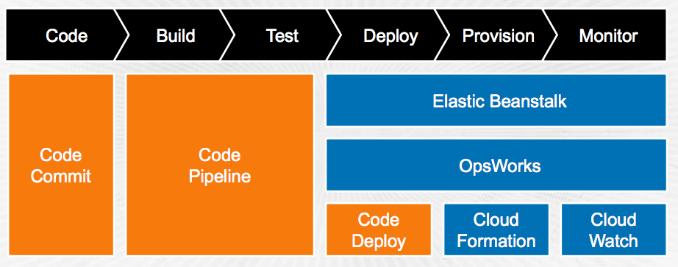
Deployment examples

